Slide 1
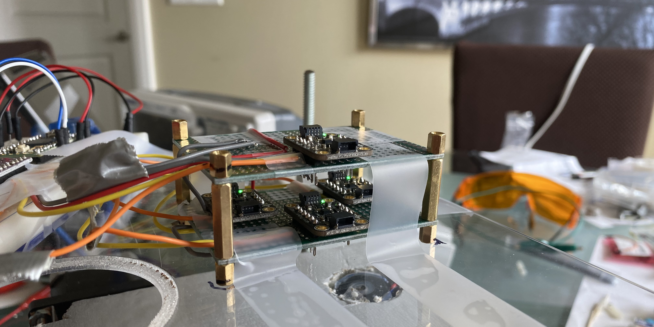
CSE 490V VIRTUAL REALITY SYSTEMS
Finger Tracking using Magnetometers
Alexander Mastrangelo and Paul Yoo

Slide 2
MOTIVATION
Want high quality finger tracking
Want to avoid cameras

Slide 3
OVERVIEW
Position Tracking using Magnetometers:

Slide 4
RELATED WORK

Slide 5
TOPIC 1
Alternatives to magnetic tracking:
Camera based tracking
Lighthouse
Very precise IMU

Slide 6
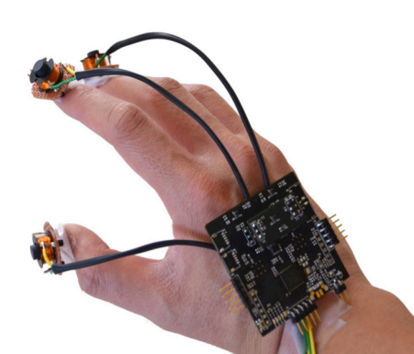
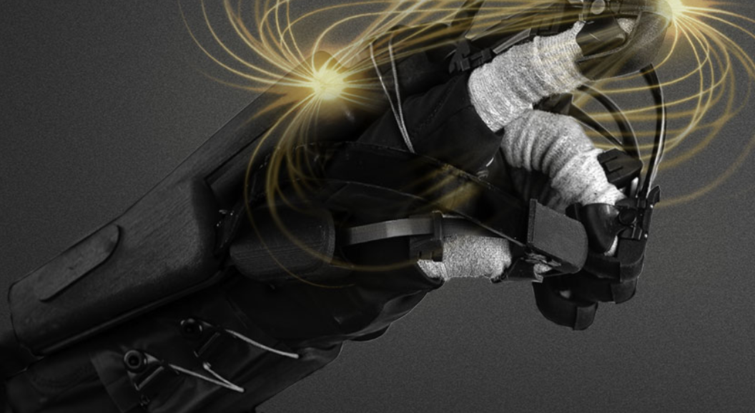
TOPIC 2
Previous Work:
Finexus tracking system
HaptX glove

Slide 7
METHOD

Slide 8
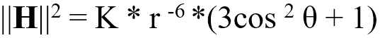
EXPLAINATION OF THEORY/CONCEPT
Begin with the magnetic dipole equation:
Then want to solve for H based on (x,y,z)
F

Slide 9
IMPLEMENTATION DETAILS

Slide 10
HARDWARE AND SOFTWARE DISCUSSION
Sensors mounted togther

Slide 11
HARDWARE PHOTOS AND VIDEOS

Slide 12
EVALUATION OF RESULTS

Slide 13
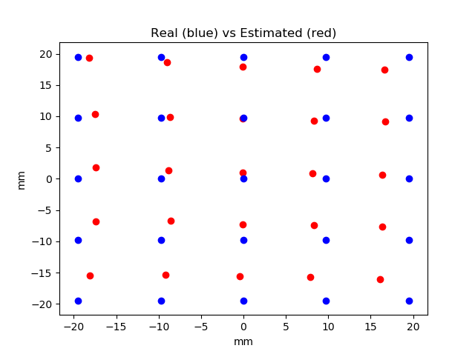
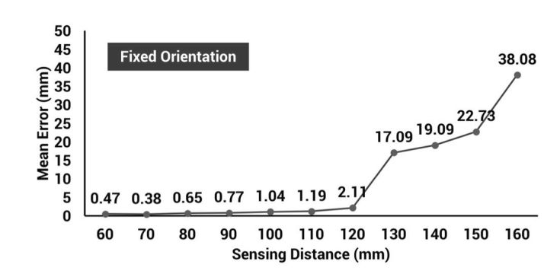
QUANTITATIVE PERFORMANCE VS. PRIOR WORK
Mean error distance:1.23 mm Std of error distance: 2.60 mm
Similar in accuracy to Finexus tracker?
Conclusion: Not Really
Source: Oculus Finexus Paper

Slide 14
DISCUSSION

Slide 15
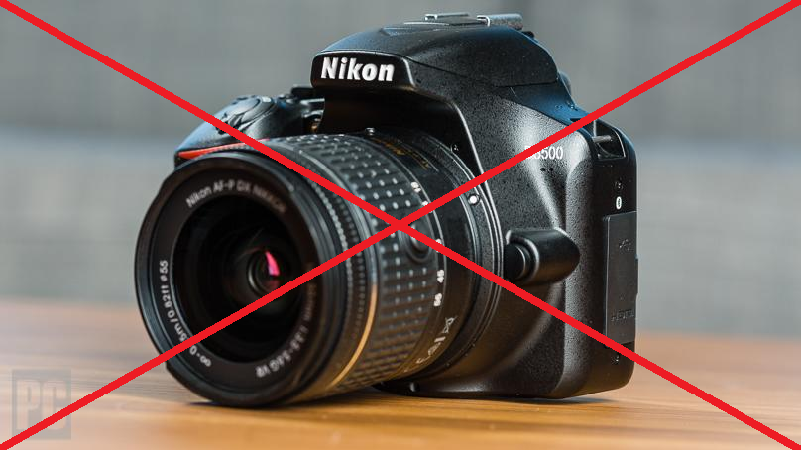
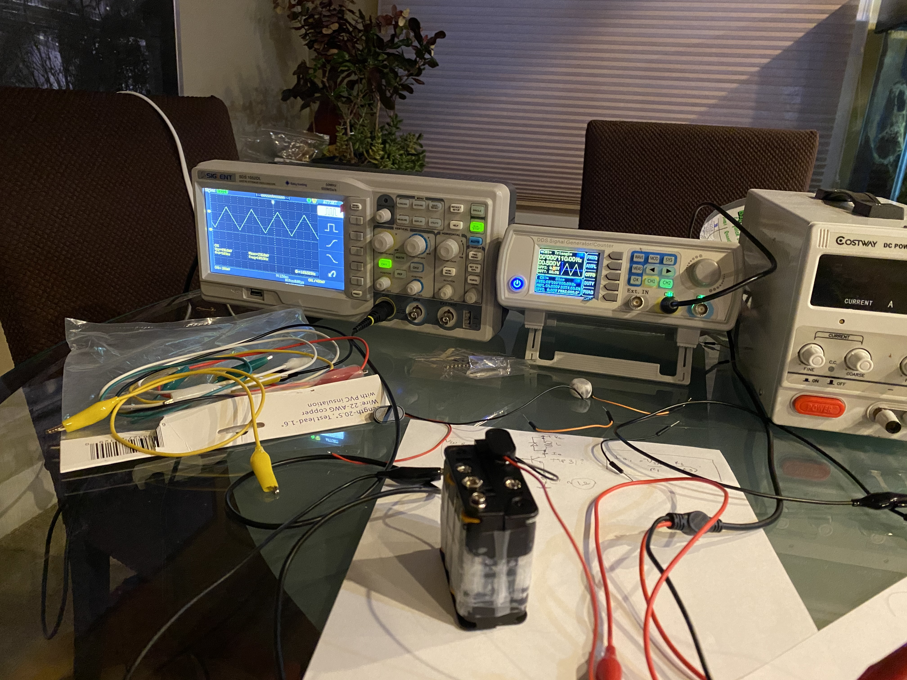
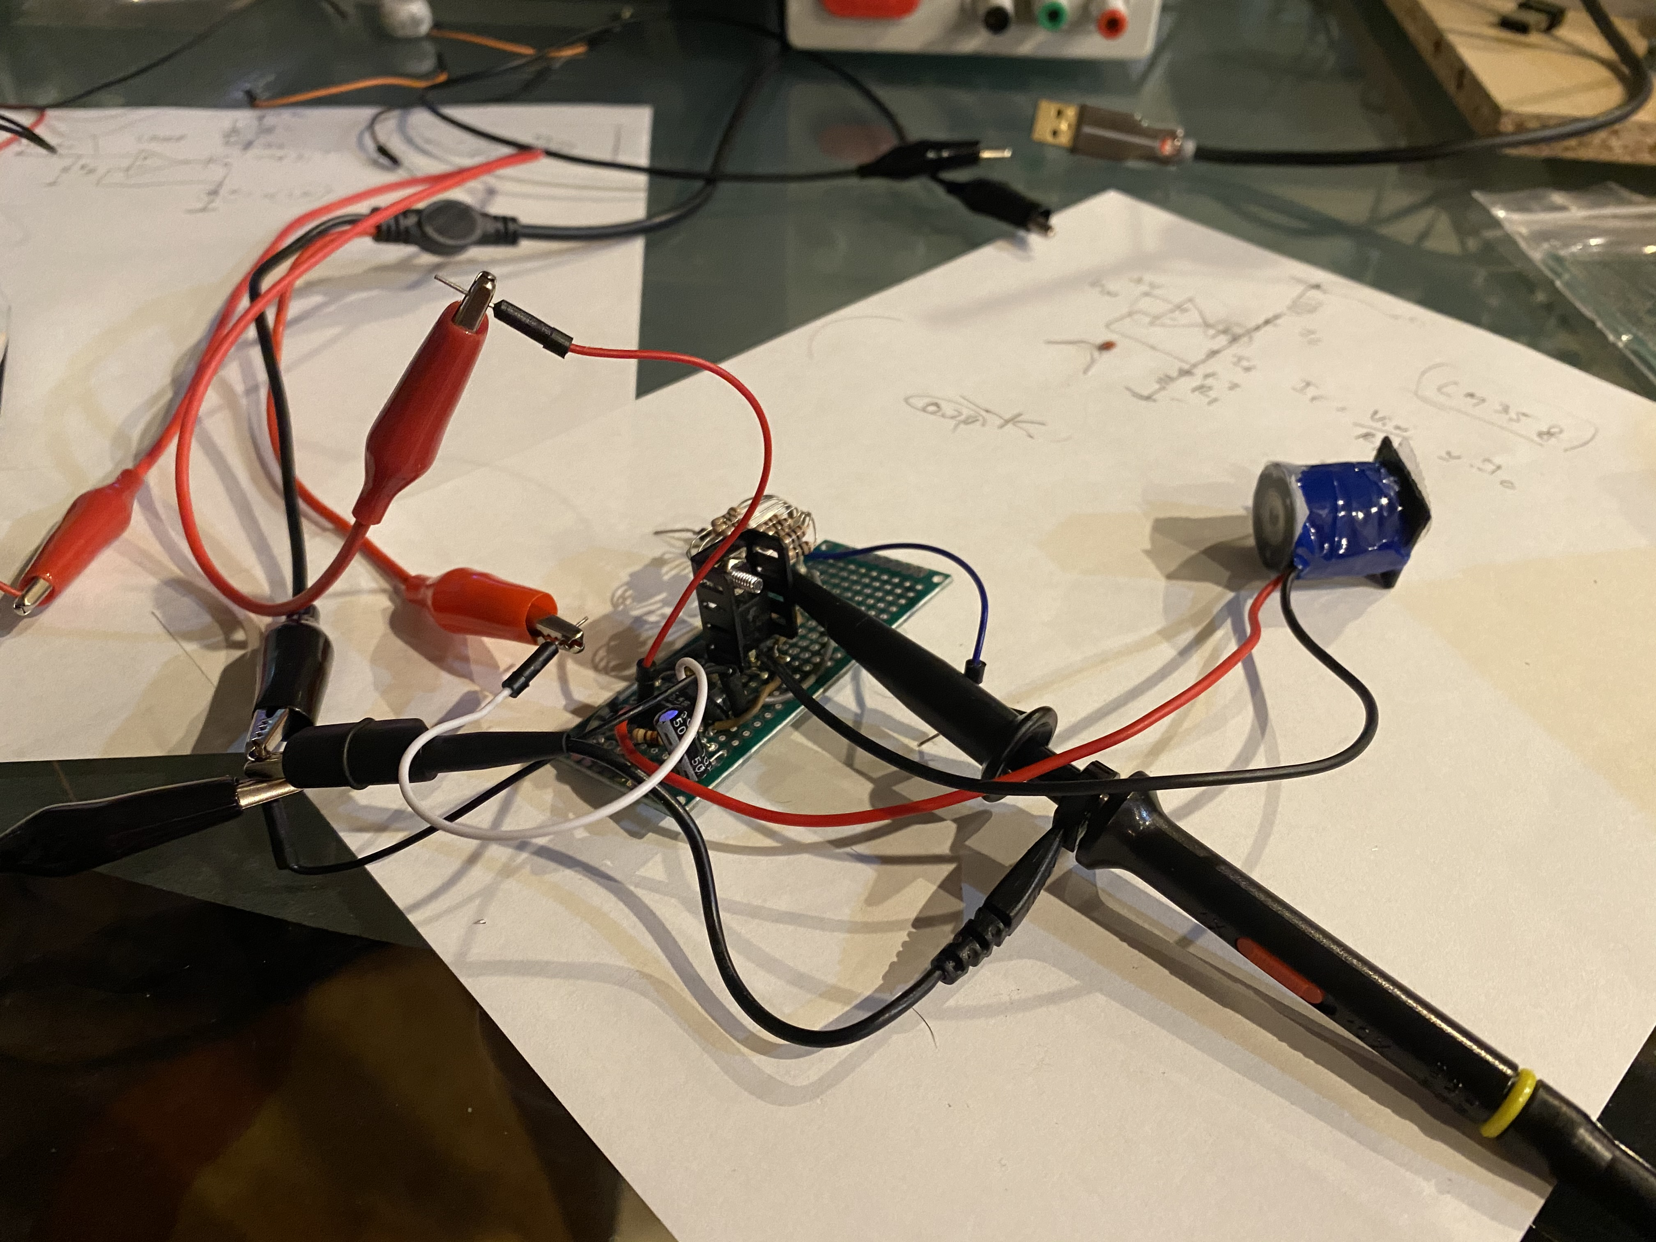
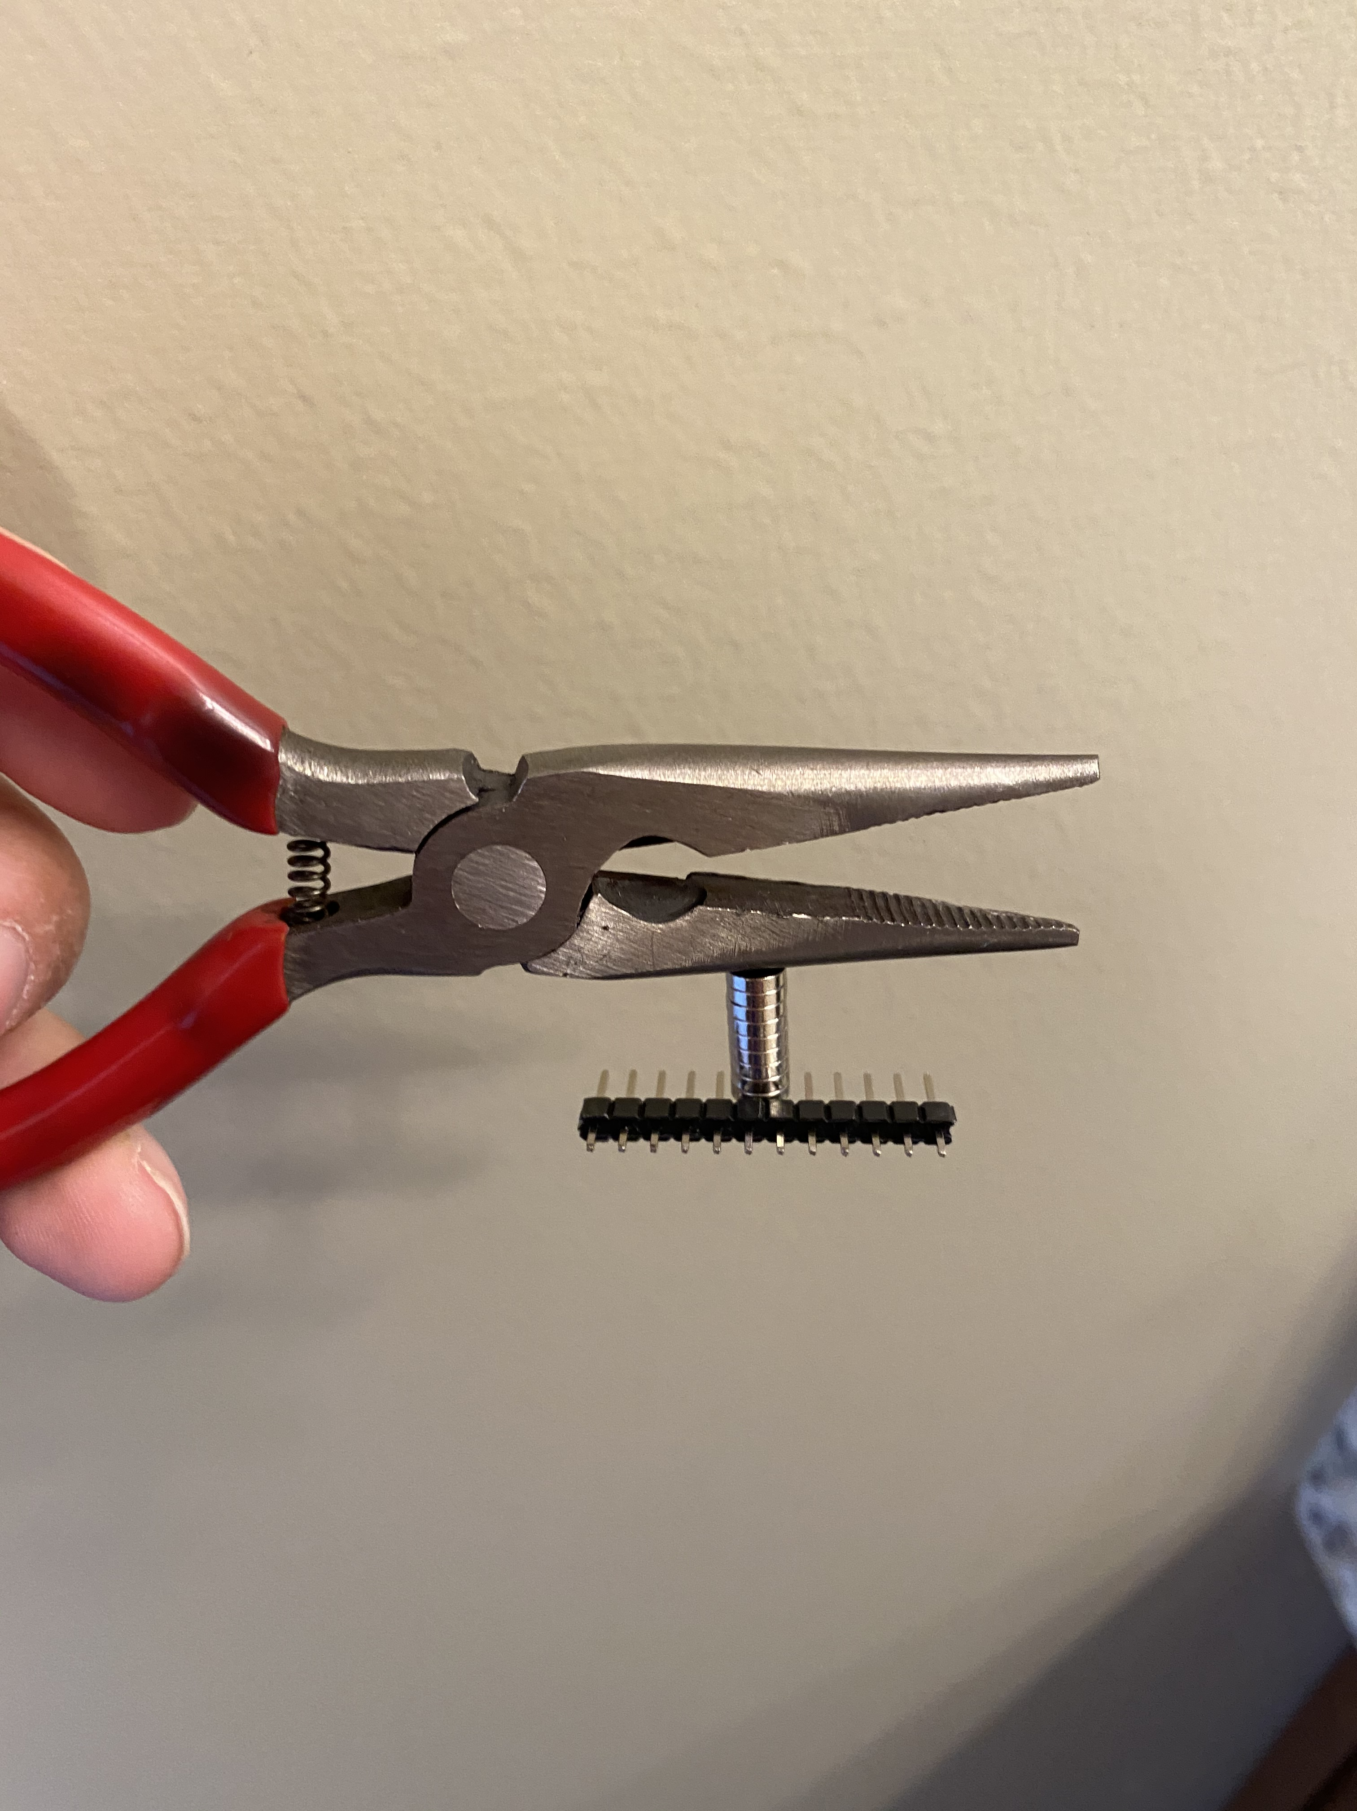
BENEFITS AND LIMITATIONS
Benefits:
No camera/lighthouse required
Doesn’t suffer from occlusion problems
Can be scaled easily to track arbitrary # of magnets
Limitations:
Affected by nearby magnetic material
Requires power and extra circuitry to drive magnets
Interferes with IMU magnetometer

Slide 16
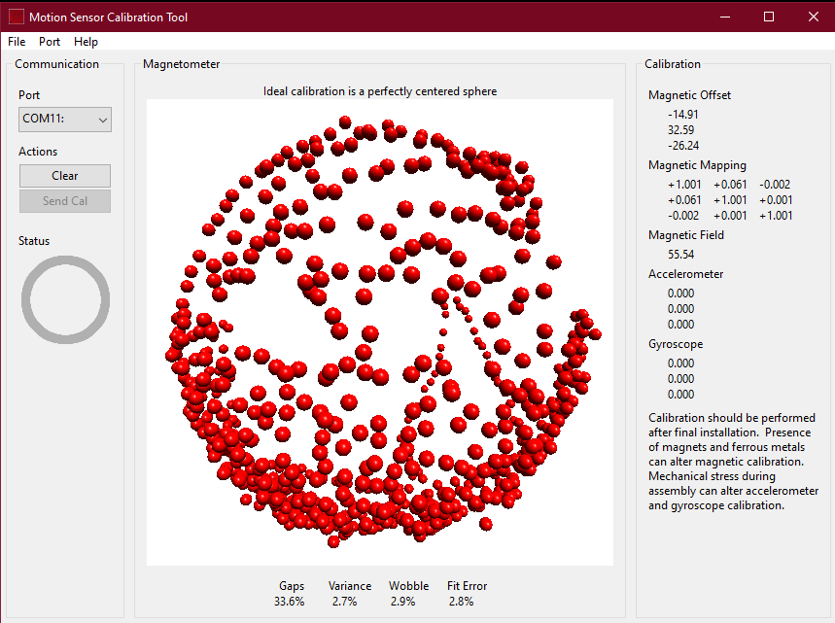

FAILURE CASES
Requires constant re-calibration
High frequency movement

Slide 17
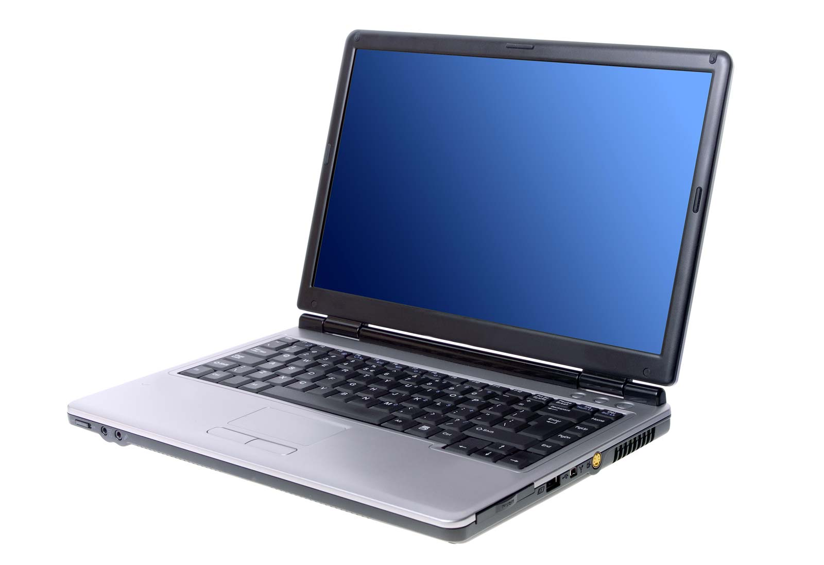
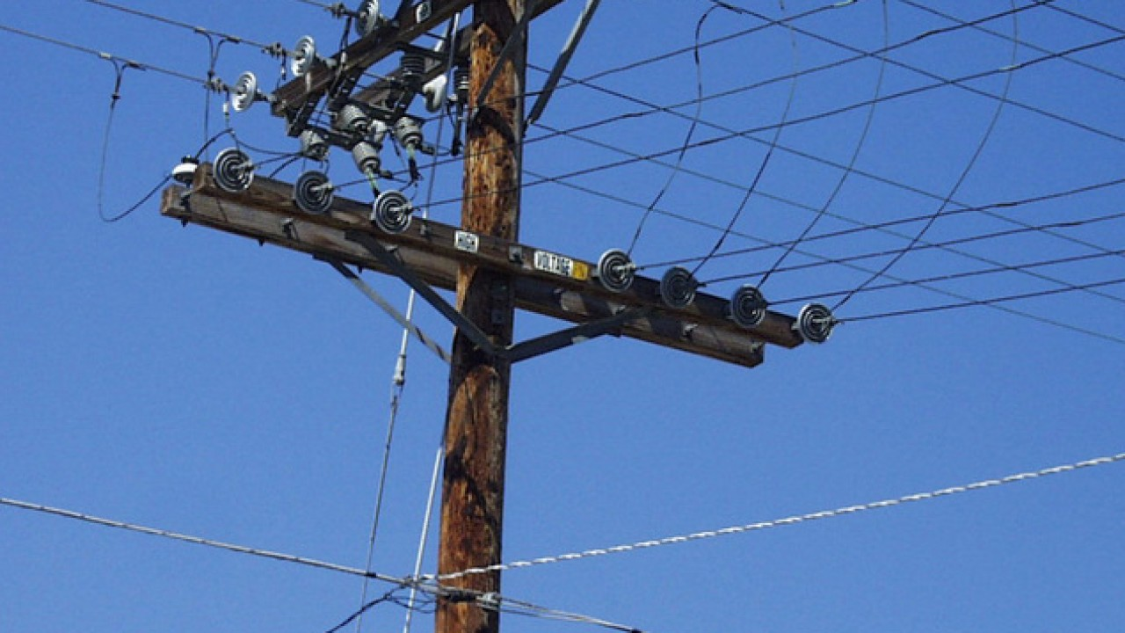
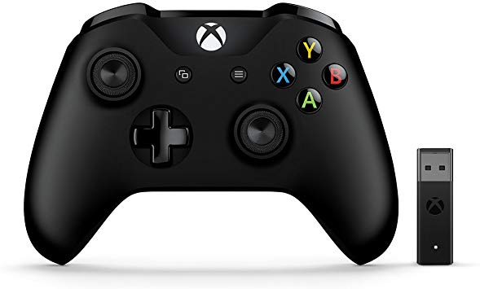
FAILURE CASES
Electrical Noise

Slide 18
CONCLUSION

Slide 19
SUMMARY OF CONTRIBUTIONS
Built a Finexus style magnetic tracker
Implemented a model to solve position of magnet
Measured accuracy of model using XY table

Slide 20
APPENDIX

Slide 21
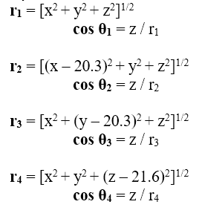
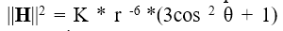
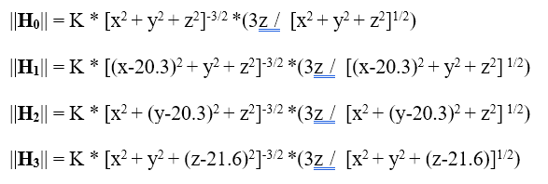
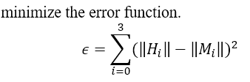
MATHEMATICAL DERIVATIONS

